Slide 1
Valve Intrapreneurship Case Study
VX423
Pan Chongdan

Slide 2

Introduction and Background
Game company founded in 1996
Encourage players to DIY the content of games
Flat organizational structure
No bosses or managers to cause organizational barrier
Every employee has the right to green-light or ship projects
Regarded as one of the most innovative IT game companies

Slide 3
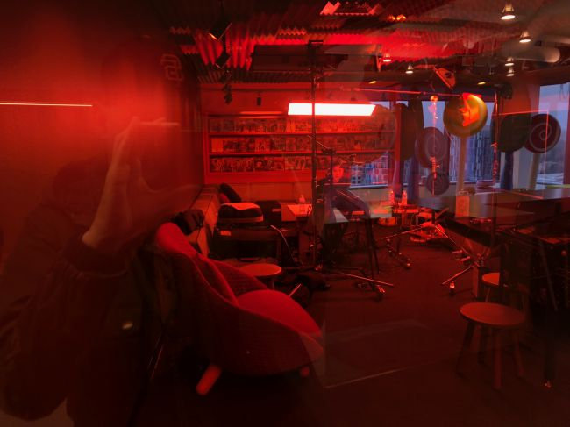
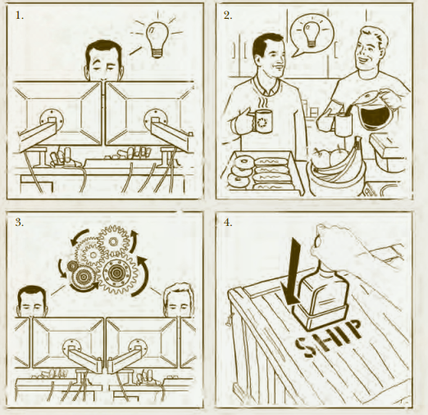
Valve Intrapreneurship characteristics
Communication
Desks with wheels encourage employees to keep moving around to know about others’ work
A well developed internal website to improve the efficiency of communication
Process and Procedure
Everyone is free to start a project or be part of any project at anytime
Quite simple and high efficient

Slide 4
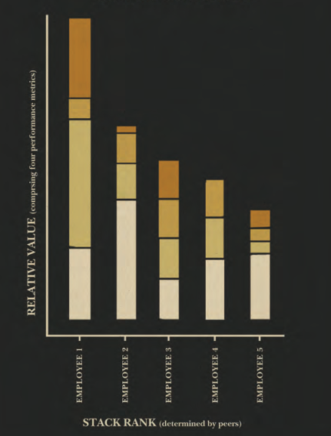
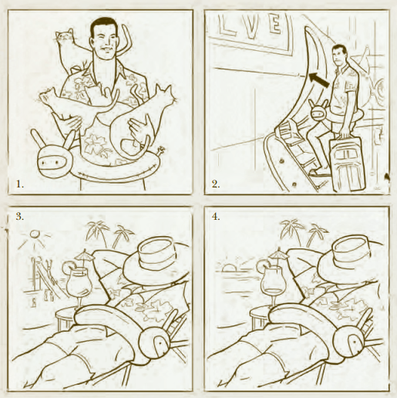
Valve Intrapreneurship characteristics
Policies
Everyone should be take part in the interview loop
Important projects should be carried out in group to lower risks
Everyone will receive peer review and stack ranking to improve his performance
Culture
Nobody should be worried about unfair salary
Everyone is encouraged to make his own decision and won’t be punished because of failure
No overtime work and many holidays

Slide 5


Innovation Example in Valve
Radical Innovation
Steam Platform
A digital platform with 514 million users where they can buy and trade games or software
Let every become your staff and user
Incremental Innovation
User can add their own design to games or software and trade them
Targeted advertising to users
Keep developing advanced engine to make games
Gain Profit
Sell games and software
Make advertisements for products from other companies
Trade taxes

Slide 6
Thank you

